Slide 1
UPPER SIXTH ARTS
GEOGRAPHY
Lesson 17
Overpopulation, Underpopulation and Optimum Population
Notes:
Good morning, class, and welcome to our geography lesson. I am your geography teacher, Mr Kamdem. Today we are starting Lesson 17: Overpopulation, Underpopulation and Optimum Population.

Slide 2
CLASS INFO
Class, Chapter and Duration
Class | Upper Sixth Arts
Chapter | Module 4: Understanding and managing population dynamics across the world in general and Cameroon in particular
Duration | 2 periods (2 × 50 minutes)
Notes:
This lesson is for Upper Sixth Arts. It belongs to Module 4: Understanding and managing population dynamics across the world in general and Cameroon in particular. We shall need 2 periods to cover it.

Slide 3
IDENTIFICATION
Lesson Identification
Topic | Population Growth and Resources
Sub-topic | Population and Resource Relationships
Lesson | Lesson 17: Overpopulation, Underpopulation and Optimum Population
Notions / Concepts | Overpopulation, underpopulation, optimum population, output per person, indicators.
Syllabus focus | Meaning and situations; indicators and measurement; causes, consequences and solutions.
Competence | Learners are able to identify over-, under- and optimum population and suggest solutions.
Notes:
Our topic is Population Growth and Resources, and the sub-topic is Population and Resource Relationships. The key notions we shall use today are: overpopulation, underpopulation, optimum population, output per person, indicators. At the end, you should be able to do this: learners are able to identify over-, under- and optimum population and suggest solutions.

Slide 4

HOMEWORK CORRECTION
Correction of the Homework
Question (Lesson 16: Carrying Capacity):
Explain how carrying capacity could be raised in your area.
Notes:
Before we start the new lesson, let us correct the homework I gave you at the end of Lesson 16: Carrying Capacity. The question was: Explain how carrying capacity could be raised in your area. Take out your exercise books.

Slide 5
HOMEWORK CORRECTION
Correction: Possible Answer
In our area, carrying capacity could be raised by irrigation from the Benue, using manure and improved seeds, soil conservation, controlled grazing and tree planting.
Notes:
Here is a good answer. In our area, carrying capacity could be raised by irrigation from the Benue, using manure and improved seeds, soil conservation, controlled grazing and tree planting. Compare it with your own answer and correct your work in red.

Slide 6
LESSON PLAN
Lesson Plan
Correction of the homework
Objectives and recall
Real-life situation and action to take
Learning activities
Board summary
Evaluation, remediation and homework
Notes:
Here is the plan of our lesson today. First, we shall correct the homework. Then we shall look at the objectives and recall what you already know. After that, we shall study a situation from real life and the action to take, and do the learning activities. Finally, we shall copy the board summary, do the evaluation and the remediation, and I will give you the homework.

Slide 7
OBJECTIVES
Objectives
By the end of this lesson, you should be able to:
Define over-, under- and optimum population.
Give indicators and examples of each.
Notes:
Take your time to copy this part; we will continue together.

Slide 8
OBJECTIVES
Objectives (continued)
Explain causes, consequences and solutions.
Notes:
By the end of this lesson, you should be able to do three things. Number 1: define over-, under- and optimum population. Number 2: give indicators and examples of each. Number 3: explain causes, consequences and solutions.

Slide 9
PREVIOUS KNOWLEDGE
Previous Knowledge
Carrying capacity is the limit of support.
Technology can raise production.
Notes:
Let us first remember what you already know. Carrying capacity is the limit of support. Technology can raise production. Keep this in mind, because we shall build on it today.

Slide 10
REAL-LIFE SITUATION
Situation in Real Life
In some villages of the West Region, fields are tiny and young people leave. In the East, large forests have few people and roads, and many resources are not used.
Notes:
Listen carefully to this situation from real life. In some villages of the West Region, fields are tiny and young people leave. In the East, large forests have few people and roads, and many resources are not used. Think about it, because I am going to ask you some questions.

Slide 11
REAL-LIFE SITUATION
Situation: Question 1
What is the problem in the situation?
Notes:
Question 1: What is the problem in the situation? Think for a moment, then raise your hand to answer.

Slide 12
REAL-LIFE SITUATION
Answer
Some areas have too many people and others too few for their resources.
Notes:
Good. Some areas have too many people and others too few for their resources.

Slide 13
REAL-LIFE SITUATION
Situation: Question 2
What is the West village situation called?
Notes:
Question 2: What is the West village situation called? Think for a moment, then raise your hand to answer.

Slide 14
REAL-LIFE SITUATION
Answer
Overpopulation (local).
Notes:
Good. Overpopulation (local).

Slide 15
REAL-LIFE SITUATION
Situation: Question 3
What is the East situation called?
Notes:
Question 3: What is the East situation called? Think for a moment, then raise your hand to answer.

Slide 16
REAL-LIFE SITUATION
Possible Answer
Underpopulation.
Notes:
Good. Underpopulation.

Slide 17
ACTION TO TAKE
Action to Take
Identify population–resource imbalances and propose solutions.
Notes:
From this situation, the action we are working towards in this lesson is the following: identify population–resource imbalances and propose solutions.

Slide 18
JUSTIFICATION
Justification of the Lesson
This lesson helps us to understand the balance between people and resources.
Notes:
Why is this lesson important for you? This lesson helps us to understand the balance between people and resources.

Slide 19
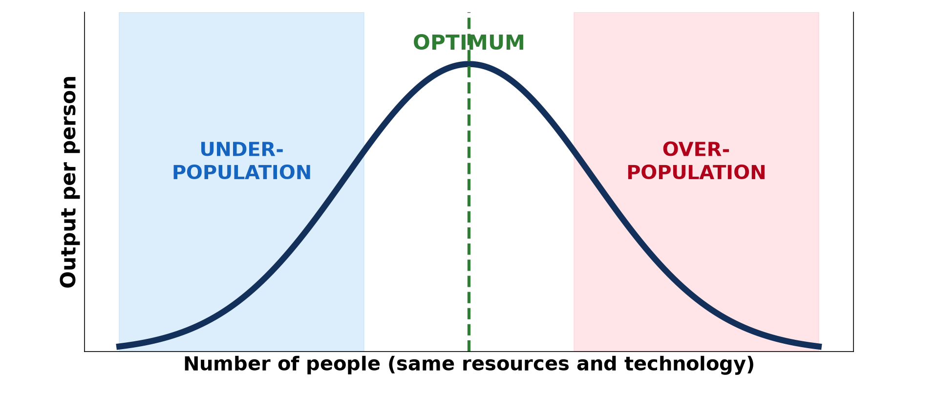
1. THE CONCEPTS
Activity 1
Output per person and population size.
Notes:
Activity 1. Look carefully at this diagram: output per person and population size. Observe every detail before I ask the question.

Slide 20
1. THE CONCEPTS
Activity 1: Question
What is optimum population?
Notes:
Here is the question for Activity 1: What is optimum population? Take one minute to think and write your answer in your rough notebook.

Slide 21
1. THE CONCEPTS
Activity 1: Answer
The number of people that gives the highest output per person.
Notes:
Let us check the answer together. The number of people that gives the highest output per person.

Slide 22

2. OVERPOPULATION: INDICATORS
Activity 2
A crowded market.
Notes:
Activity 2. Look carefully at this picture: a crowded market. Observe every detail before I ask the question.

Slide 23
2. OVERPOPULATION: INDICATORS
Activity 2: Question
Give two indicators of overpopulation.
Notes:
Here is the question for Activity 2: Give two indicators of overpopulation. Take one minute to think and write your answer in your rough notebook.

Slide 24
2. OVERPOPULATION: INDICATORS
Activity 2: Answer
Unemployment and food shortages (also slums, land shortage, emigration).
Notes:
Let us check the answer together. Unemployment and food shortages (also slums, land shortage, emigration).

Slide 25

2. OVERPOPULATION: CONSEQUENCES
Activity 3
Dry, degraded land.
Notes:
Activity 3. Look carefully at this picture: dry, degraded land. Observe every detail before I ask the question.

Slide 26
2. OVERPOPULATION: CONSEQUENCES
Activity 3: Question
How can overpopulation damage the environment?
Notes:
Here is the question for Activity 3: How can overpopulation damage the environment? Take one minute to think and write your answer in your rough notebook.

Slide 27
2. OVERPOPULATION: CONSEQUENCES
Activity 3: Answer
Overgrazing, deforestation and soil erosion.
Notes:
Let us check the answer together. Overgrazing, deforestation and soil erosion.

Slide 28
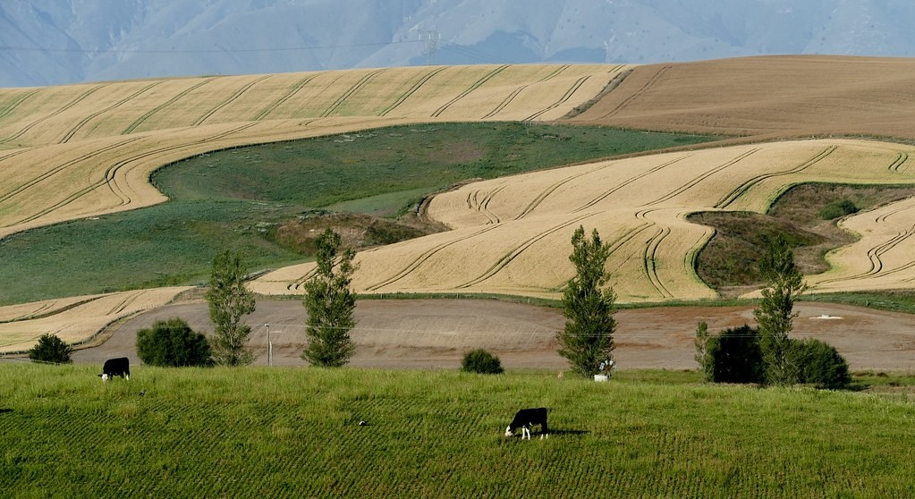
3. UNDERPOPULATION
Activity 4
Large wheat fields in New Zealand.
Notes:
Activity 4. Look carefully at this picture: large wheat fields in New Zealand. Observe every detail before I ask the question.

Slide 29
3. UNDERPOPULATION
Activity 4: Question
Why do some countries have too few people?
Notes:
Here is the question for Activity 4: Why do some countries have too few people? Take one minute to think and write your answer in your rough notebook.

Slide 30
3. UNDERPOPULATION
Activity 4: Answer
Rich resources but not enough workers to use them.
Notes:
Let us check the answer together. Rich resources but not enough workers to use them.

Slide 31

4. SOLUTIONS
Activity 5
Planting trees.
Notes:
Activity 5. Look carefully at this picture: planting trees. Observe every detail before I ask the question.

Slide 32
4. SOLUTIONS
Activity 5: Question
Give two solutions to overpopulation.
Notes:
Here is the question for Activity 5: Give two solutions to overpopulation. Take one minute to think and write your answer in your rough notebook.

Slide 33
4. SOLUTIONS
Activity 5: Answer
Family planning and better farming (also industry, migration, resettlement).
Notes:
Let us check the answer together. Family planning and better farming (also industry, migration, resettlement).

Slide 34
BOARD SUMMARY
Board Summary
Topic: Population Growth and Resources
Sub-topic: Population and Resource Relationships
Lesson 17: Overpopulation, Underpopulation and Optimum Population
Notes:
Now we are going to copy the board summary. Write the title and the headings neatly in your notebooks. I will give you enough time for each slide, so do not rush.

Slide 35
BOARD SUMMARY
1. Meaning of the Concepts
The main concepts can be understood as follows:
Overpopulation: It is a situation where there are too many people for the resources and technology available, so living standards fall.
Notes:
Let us copy Meaning of the Concepts. The main concepts can be understood as follows. On this slide we have Overpopulation. Write each point on a new line, with the key term first, and explain it in your own words when we revise. When you finish, we go to the next slide.

Slide 36
BOARD SUMMARY
1. Meaning of the Concepts (continued)
Underpopulation: It is a situation where there are too few people to use the resources fully and efficiently.
Notes:
We continue with Meaning of the Concepts. On this slide we have Underpopulation. Write each point on a new line, with the key term first, and explain it in your own words when we revise. When you finish, we go to the next slide.

Slide 37
BOARD SUMMARY
1. Meaning of the Concepts (continued)
Optimum population: It is the number of people that gives the highest standard of living with the available resources and technology. It changes when technology changes.
Notes:
We continue with Meaning of the Concepts. On this slide we have Optimum population. Write each point on a new line, with the key term first, and explain it in your own words when we revise.

Slide 38
BOARD SUMMARY
1. Meaning of the Concepts
Illustration: optimum population
Notes:
Now draw this illustration in your notebook: optimum population. Give it a title and label it clearly.

Slide 39
BOARD SUMMARY
2. Overpopulation
Overpopulation can be studied as follows:
Indicators and measurement: High unemployment, malnutrition, slums, landlessness and very high physiological density indicate overpopulation. It is measured by comparing population with resources and GNI per person.
Notes:
Let us copy Overpopulation. Overpopulation can be studied as follows. On this slide we have Indicators and measurement. Write each point on a new line, with the key term first, and explain it in your own words when we revise. When you finish, we go to the next slide.

Slide 40
BOARD SUMMARY
2. Overpopulation (continued)
Causes: Rapid population growth and limited resources or technology cause it. Examples are Bangladesh, the Sahel and parts of the Mandara Mountains.
Notes:
We continue with Overpopulation. On this slide we have Causes. Write each point on a new line, with the key term first, and explain it in your own words when we revise. When you finish, we go to the next slide.

Slide 41
BOARD SUMMARY
2. Overpopulation (continued)
Consequences and solutions: It leads to poverty, migration and environmental damage such as soil erosion. Solutions are family planning, intensification of agriculture, industrialisation and migration.
Notes:
We continue with Overpopulation. On this slide we have Consequences and solutions. Write each point on a new line, with the key term first, and explain it in your own words when we revise.

Slide 42
BOARD SUMMARY
3. Underpopulation
Underpopulation can be studied as follows:
Indicators and causes: Resources are unused, labour is scarce and markets are small. Causes are low birth rates, emigration or very large territories, as in Australia, Canada and the East Region of Cameroon.
Notes:
Let us copy Underpopulation. Underpopulation can be studied as follows. On this slide we have Indicators and causes. Write each point on a new line, with the key term first, and explain it in your own words when we revise. When you finish, we go to the next slide.

Slide 43
BOARD SUMMARY
3. Underpopulation (continued)
Consequences and solutions: Development is slow, and services are expensive for scattered people. Solutions are encouraging immigration, pro-natal policies and better transport.
Notes:
We continue with Underpopulation. On this slide we have Consequences and solutions. Write each point on a new line, with the key term first, and explain it in your own words when we revise.

Slide 44
FORMATIVE EVALUATION
Evaluation 1
Define optimum population.
Notes:
Now let us check what you have understood. Question 1: Define optimum population. Answer in your exercise book.

Slide 45
FORMATIVE EVALUATION
Expected Answer
The population that gives the highest standard of living.
Notes:
The expected answer is: the population that gives the highest standard of living. If you got it right, well done.

Slide 46
FORMATIVE EVALUATION
Evaluation 2
Give two indicators of overpopulation.
Notes:
Now let us check what you have understood. Question 2: Give two indicators of overpopulation. Answer in your exercise book.

Slide 47
FORMATIVE EVALUATION
Expected Answer
Unemployment and food shortages (also slums, emigration).
Notes:
The expected answer is: unemployment and food shortages (also slums, emigration). If you got it right, well done.

Slide 48
REMEDIATION
Remediation
Fill in the blanks:
Too few people for the resources is ______.
The best balance of people and resources is ______ population.
Canada is an example of ______.
Notes:
For those who need more practice, fill in the blanks in your exercise book. The answers are: number 1, underpopulation; number 2, optimum; number 3, underpopulation.

Slide 49
HOMEWORK
Homework
Is Cameroon over-, under- or optimally populated? Write a paragraph with evidence.
Notes:
For your homework: Is Cameroon over-, under- or optimally populated? Write a paragraph with evidence. We shall correct it at the beginning of our next lesson.

Slide 50
NEXT LESSON
Next Lesson
Our next lesson will be on:
Lesson 18: Theories of Population and Resources: Malthus and Boserup
Notes:
Our next lesson will be on Lesson 18: Theories of Population and Resources: Malthus and Boserup. Thank you for your attention, and see you next time.

Slide 51
BILINGUAL GAME
Bilingual Game (Jeu Bilingue)
English | Français
Overpopulation | La surpopulation
Underpopulation | Le sous-peuplement
Optimum | L'optimum
Standard of living | Le niveau de vie
Indicator | L'indicateur
Solution | La solution
Notes:
Let us play the bilingual game. I say a word in English, and you give me the French word. Then we do the reverse.

Slide 52
LOGBOOK
Official Logbook (1/2)
Module / Topic | Population Growth and Resources
Lesson Title | Lesson 17: Overpopulation, Underpopulation and Optimum Population
Expected Learning Outcomes | Define over-, under- and optimum population. Give indicators and examples of each. Explain causes, consequences and solutions.
Competence | Learners are able to identify over-, under- and optimum population and suggest solutions.
Notes:
I record this information in the official logbook of the class after the lesson.

Slide 53
LOGBOOK
Official Logbook (2/2)
Matter Taught | Meaning of the Concepts; Overpopulation; Underpopulation.
Evaluation | Formative evaluation and remediation exercise.
Homework | Is Cameroon over-, under- or optimally populated? Write a paragraph with evidence.
Enrolment / Present / Absent | ____ / ____ / ____
Achievement | To be completed after the lesson.
Notes:
I complete the second page of the logbook: the matter taught, the evaluation, the homework and the attendance.

Slide 54
TEACHER'S NOTE
Teacher's Note
Timing: Homework correction, plan, objectives 8 min | Recall, situation, action 10 min | 5 activities 30 min | Board summary (copying) 30 min | Evaluation, remediation 10 min | Homework, next lesson 5 min | Logbook 7 min
Without the projector (Activity 1): draw the curve.
Without the projector (Activity 2): list indicators.
Without the projector (Activity 3): discuss the Sahel.
Without the projector (Activity 4): find Canada and Australia.
Without the projector (Activity 5): list solutions.
Notes:
This slide is for me, the teacher: it gives the timing of the lesson and what to do if the projector is not available.

Slide 55
REFERENCES
References
National Geography Syllabus, MINESEC/IGE/IP-SS, 2019 — Module 4 (Population Geography).
Photo, Activity 2: “Wax market” by zouzouwizman, CC BY 2.0, via Flickr (https://www.flickr.com/photos/61111202@N00/12129001)
Photo, Activity 3: “Imagine a world without trees” by aloshbennett, CC BY 2.0, via Flickr (https://www.flickr.com/photos/13203757@N00/3480223314)
Photo, Activity 4: “Wheat fields. New Zealand.” by Bernard Spragg, CC0 1.0, via Flickr (https://www.flickr.com/photos/88123769@N02/24607172362)
Photo, Activity 5: “Haitian Students Breathe New Life into Depleted Pine Forest” by United Nations Photo, CC BY-NC-ND 2.0, via Flickr (https://www.flickr.com/photos/35483578@N03/5860275159)
Diagrams and animations: drawn for this lesson (Geography Department).
Notes:
These are the references and picture credits used to prepare this lesson.

